Slide 1

Predictive Modeling for Customer Behavior
This presentation outlines a predictive modeling approach.
It helps businesses understand customer churn and loyalty.
Our goal is to predict customer retention, churn, or prospect status.
We use shopping habits and background data to achieve this.

Slide 2
Dataset Description and Creation
Dataset Origin
Feature Details
Target Variable
We created a self-made dataset.
The dataset has over 35 columns.
The "target" column classifies customers.
It includes customer details like age, purchases, and feedback.
Features include demographics and purchase history.
Categories are Retained, Churned, or Prospective.
Market trends are also incorporated.
Economic indicators are also present.
Data was manually curated for realism.

Slide 3



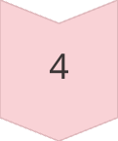

Key Preprocessing Steps
Missing Values
Numeric data filled with mean values.
Noise Removal
Duplicates removed and custom reduction applied.
Normalization
MinMaxScaler used for numeric features.
Encoding
Categorical variables label-encoded.
Feature Engineering
Added sum and mean features.
PCA used for dimensionality reduction.

Slide 4
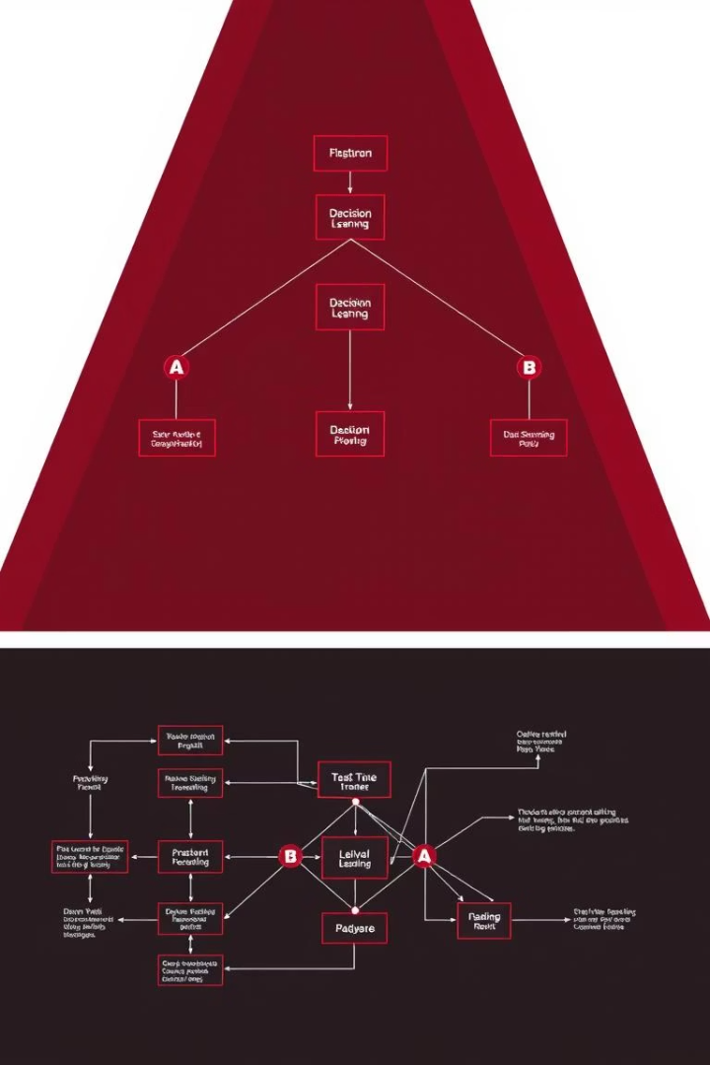
Model Selection and Evaluation
1
Logistic Regression
Interpretable as a baseline model.
Offers clear insights into feature impact.
2
Random Forest Classifier
Handles complex patterns effectively.
Combines multiple decision trees for accuracy.
3
Evaluation Metrics
Accuracy, Precision, Recall, F1 Score were used.
Confusion Matrix provides detailed insights.
5-fold Cross-Validation ensures robustness.

Slide 5
Model Results: Logistic Regression
Actual Retained (0)
241
18
57
Actual Churned (1)
38
31
82
Actual Prospective (2)
18
11
389
Logistic Regression shows high predictive power.
It identifies 241 true negatives for retained customers.
Strong recall is observed for prospective customers (389).
Overall, balanced performance across classes is evident.

Slide 6
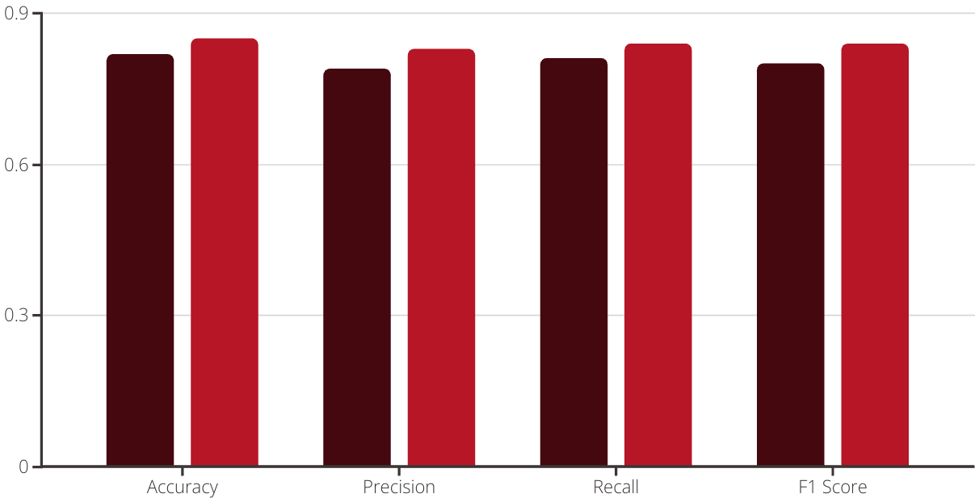
Model Results: Random Forest
Logistic Regression
Random Forest
Random Forest achieves slightly better accuracy (248 true negatives).
It shows improved precision and recall, especially for the churned class (34).
This model demonstrates superior pattern recognition capabilities.

Slide 7
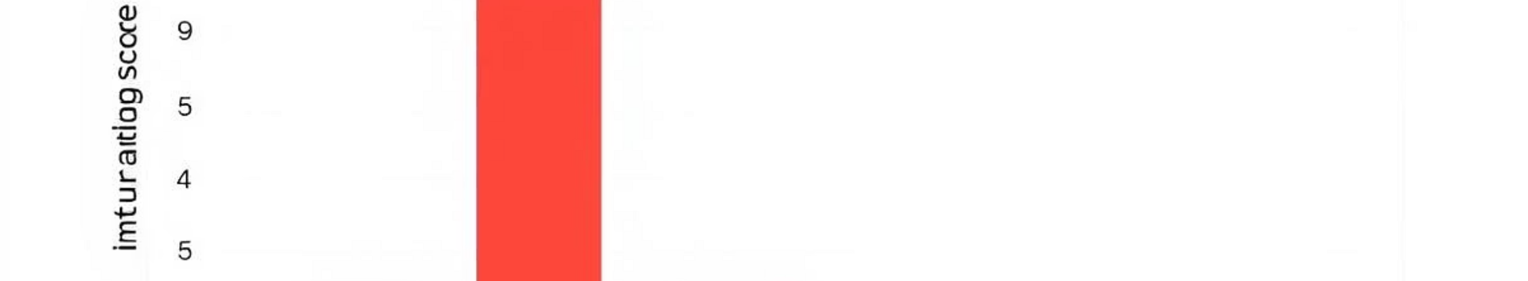




Final Insights and Feature Importance
Top Features
Unexpected Finding
Model Comparison
Business Impact
Q2 Positive Feedback Count (0.14) is key.
Market Volatility showed minimal impact.
Random Forest outperforms Logistic Regression.
Focus on feedback and satisfaction scores.
Q1 Satisfaction Score (0.12) also drives predictions.
This was surprising given economic context.
It excels in complex, nuanced scenarios.
This can reduce churn and attract new prospects.

Slide 8
Conclusion and Future Work
Successful Prediction
Models successfully predict customer behavior.
This aids effective customer retention strategies.
Real-time Data
Incorporate real-time data for dynamic predictions.
This enhances responsiveness to changes.
Deep Learning
Explore deep learning for enhanced accuracy.
This can capture more intricate patterns.
Sentiment Analysis
Add customer sentiment analysis from text feedback.
This provides qualitative insights.
Deployment
Deploy model with business feedback loop.
This enables continuous improvement.

